Slide 1
Euclid: The Infinitude of Primes
325 - 285 BC
Journey Through Genius Pp 61
Notes:
Book II - VI:
**insert Prop II.4** // Book II explored geometric algebra
**insert Prop III.22** // Book III mostly explored circles
Book IV dealt with inscribing and circumscribing figures // Prop IV.4 showed how to inscribe a circle into a triangle by making the center of the circle the point where all the vertex angle bisectors meet and then Prop IV.5 showed how to circumscribe a circle about a triangle by making the center of the circle the intersection of the perpendicular bisectors of the triangle sides
Euclid then went on to constructing “perfect” polygons, whose sides and angles are all of equal measure
Prop IV.11 Euclid inscribed a pentagon in a circle
Prop IV.15 inscribed a hexagon in a circle
The final construction, is a regular 15 sided polygon inscribed in a circle, **Activity: look at Euclid’s construction of the 15 sided polygon**
Nowhere does Euclid mention constructing a 7-, 9-, or 17-gon, since it did not fit the convenient doubling method
It was shocking when Carl Friedrich Gauss constructed the regular 17-gon in 1796, this left his mark as a mathematical genius
Book V was reserved for continuing Eudoxus’ ideas, proving to be so profound as to influence thinking even in the nineteenth century about irrational numbers
Book VI:
Book VI dealt with similar plane figures in plane geometry
Def VI.1: Similar rectilineal figures are such as have their angles severally equal and the sides about the equal angles proportional
**insert Prop VI.8 and proof**
With the thirty-third propositions summed up, thus ends the development of Euclid’s plane geometry. The next section had proven to be a gold mine for mathematicians through the years
Number Theory in Euclid:
Book VII begins with 22 new definitions involving the whole number
Even, odd, prime, composite, perfect number (a number that is the sum of its “parts” meaning its proper divisors)
Euclid starts with the renown, Euclidean Algorithm, an algorithm for finding the greatest common divisor of any two given number
**insert euclidean algorithm example here**
Prop VII.30: if p, prime, p|ab, then p|a or p|b
**insert Prop VII.31 and proof** the proof remains identical to that found in modern day number theory
Book VII, VIII, and IX flow into one another seamlessly, leaving one to wonder why they are divided into three different books, but nevertheless.
All books lead to the all important Prop IX.14: fundamental theorem of arithmetic, any number can be factored into a unique factorization of primes
**include example: suppose we have many powers of 8 and want to know how many powers do we need to get a number that ends in 0? Suppose N is the number that ends in 0, composed of powers of 8, if we write the prime factorization of N, since it is powers of 8, it will be a long string of 2 since 8 = 2*2*2. Thus is N ends in 0, then it is divisible by 10, and therefore would necessarily be divisible by 5, but this is contradictory since N is just a string of 2’s. **
Mathematicians would write out the first few primes looking for patterns, but the patterns they could come up with did not give insight into being able to predict what the next prime is. They realized that they are all odd and as the numbers get larger, the primes get scarcer.
It led Greek mathematicians to believe that the primes would grow so scarce as to completely disappear.
Euclid was not swayed, his Proposition IX.20: the infinitude of primes, which leads us to our next great theorem

Slide 2
Book II through VI **we will examine some key proofs from each book**
Prop II.4: If a straight line be cut at random, the square on the whole is equal to the squared on the segments and twice the rectangle contained by the segments.
Prop III.22: The opposite angles of quadrilaterals in circles are equal to two right angles.
**examine the proof of both

Slide 3
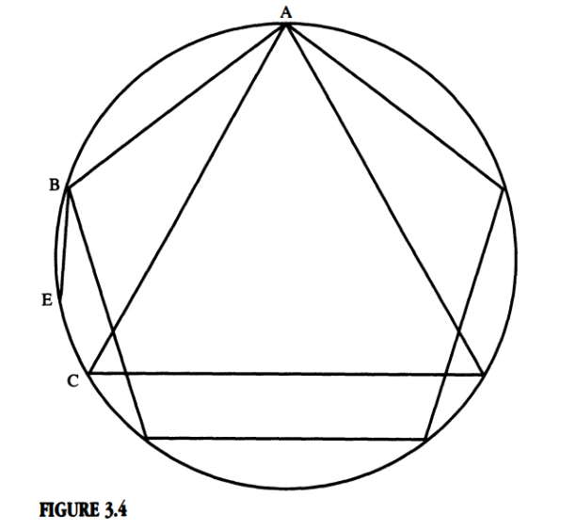
Activity
Let us look at Euclid’s construction of the 15-sided polygon (an inscribed regular pentadecagon)

Slide 4
Book V and Book VI
Book V was continuing Eudoxus’ ideas, proving to be so profound as to influence thinking -- even in the nineteenth century
Book VI dealt with similar plane figures in plane geometry
Def V.1: proposes the clear requirements for similar polygons, which requires both the corresponding angle measures are equal in each polygon, and the corresponding sides are proportional
Euclid showed in Book V -- through the works of Eudoxus -- in triangles, one of these requirements is only necessary to show similarity, therefore similar triangles are used to show similar polygons very frequently

Slide 5
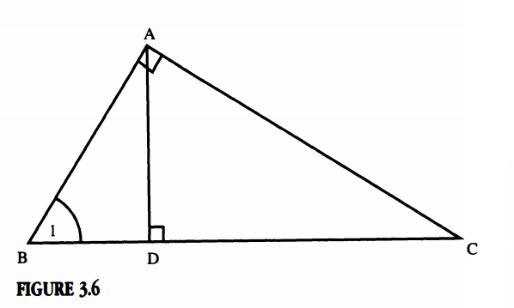
Prop VI.8: If in a right-angled triangle a perpendicular be drawn from the right angle to the base, the triangles adjoining the perpendicular are similar both to the whole and to one another

Slide 6
Number Theory in Euclid
Book VII begins with 22 new definitions involving whole numbers
Even, odd, composite, prime, perfect, etc.
Euclid begins with the Euclidean Algorithm, a way for finding the greatest common divisor of any two integers.
Perform the Euclidean Algorithm for gcd(48, 174)

Slide 7
Proofs in Number Theory
Prop VII.30: Given a prime number p, where p divides evenly a*b , then p divides a or p divides b.
Prop VII.31: Any composite number is measured by [that is divisible by] some prime number.
Examine proofs of both
Book VII, VIII, and IX all flow seamlessly into one another… leading to the all important [now] fundamental theorem of arithmetic -- we will not be examining this proof now, but we will use this theorem for its practical use

Slide 8
Prop IX.14: If a number be the least that is measured by prime numbers, it will not be measured by any other prime number except those originally measuring it.
Example: Suppose we have successive powers of 8. How many powers of 8 are necessary to reach a number that ends in 0?

Slide 9
Mathematicians began looking for patterns in primes. They knew they were all odd (with the exception of 2) and the larger the primes got, the scarer they became. Many believed they would grow so scarce as to completely disappear. But not Euclid, which leads us to out next great theorem.

